Slide 1
Niche-based grouping for mixed species growth and yield models: A preliminary exploration.
Quentin Boccaleri¹, Bronson Bullock², Stephen Kinane³, Pete Bettinger⁴
¹PMRC PhD Student, University of Georgia
²PMRC Director & Professor, University of Georgia
³PMRC Professor, University of Georgia
⁴Eyield Lead & Professor, University of Georgia

Slide 2

eYield V.2 Project
Decision support system for small and medium-sized forest landowners in the southern US.
Hardwood and natural pine.
Seven models currently in use, three of which are hardwoods.
Dr. Pete Bettinger is leading a four-year project to update to V.2: which will expand mix-species hardwoods models.
Partnership of UGA, UTK, Southern Regional Extension Forestry, and MSU staff.
Website: https://eyield.sref.info

Slide 3
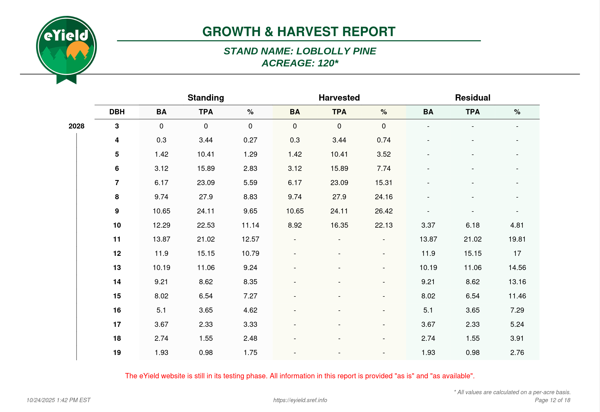

eYield V.2 Project

Slide 4
Why mix-species forests?
Over 50% of Georgia forests are owned by non-industrial private landowners.
Mix-species and uneven stands are complex to model and under-represented in the literature.
Over 250 unique native tree species in the state of Georgia.
Difficult for landowners to develop a management timeline.

Slide 5

The Great Struggle… Data!

Slide 6
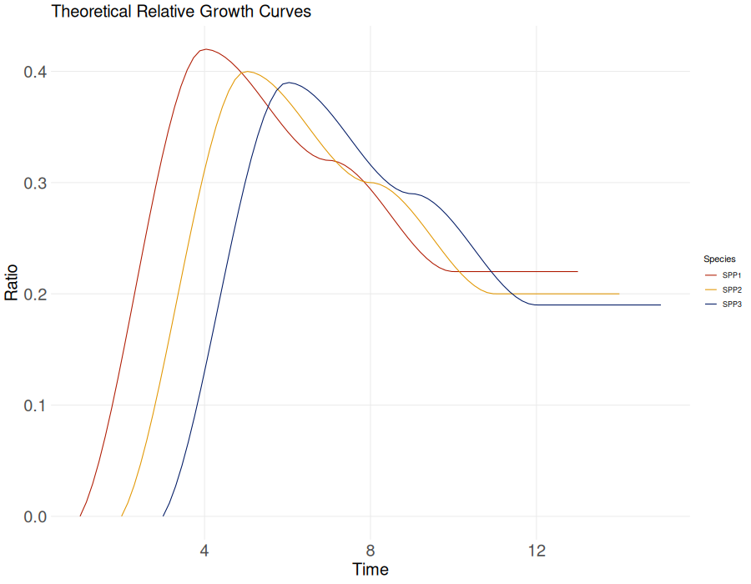
Going back to square one!

Slide 7
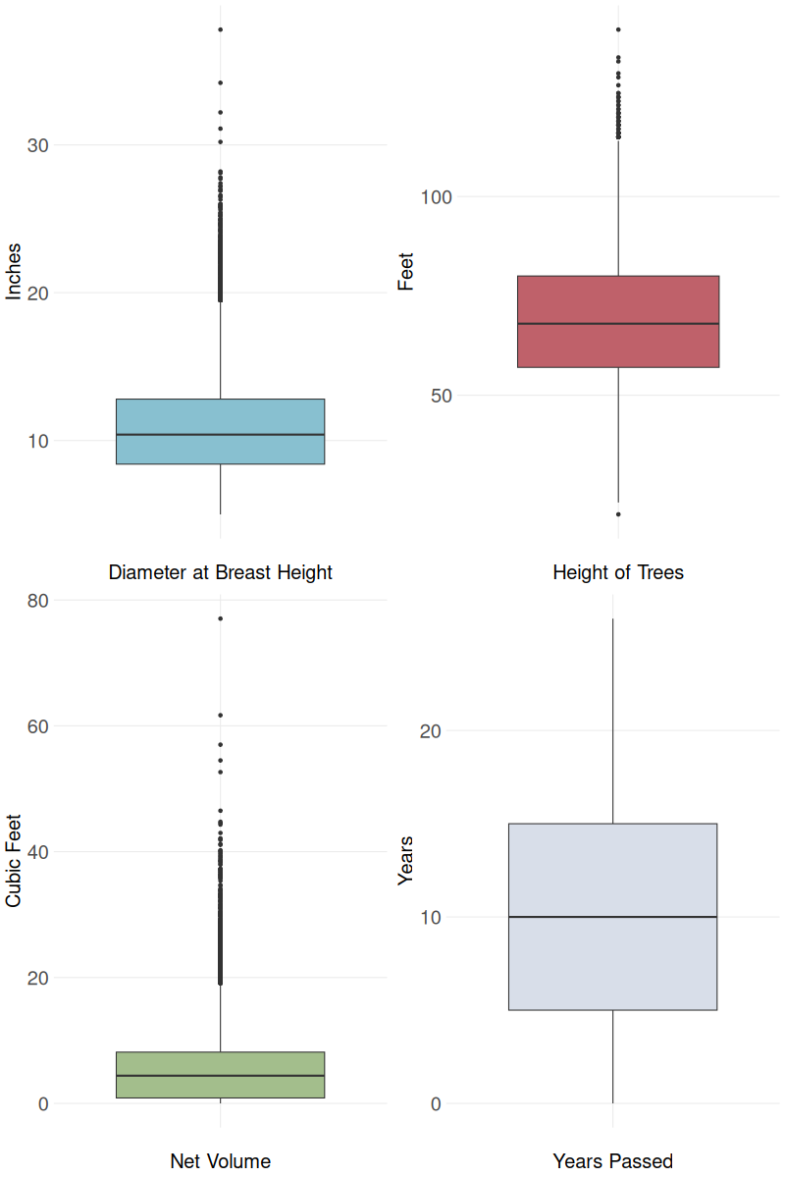
Methods
Use Forest Inventory Analysis (FIA) data to develop growth curves for a variety of species.
FIA Data from Georgia.
Loblolly, Shortleaf, Longleaf
1998 to 2023
3 or more observations for each tree.
5113 unique trees.
Relative growth based on net volume.

Slide 8
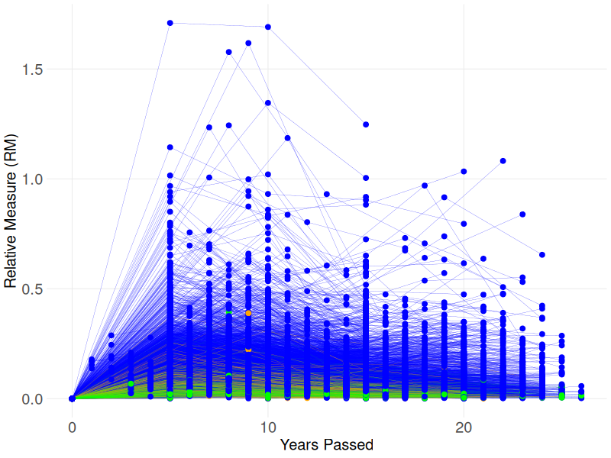
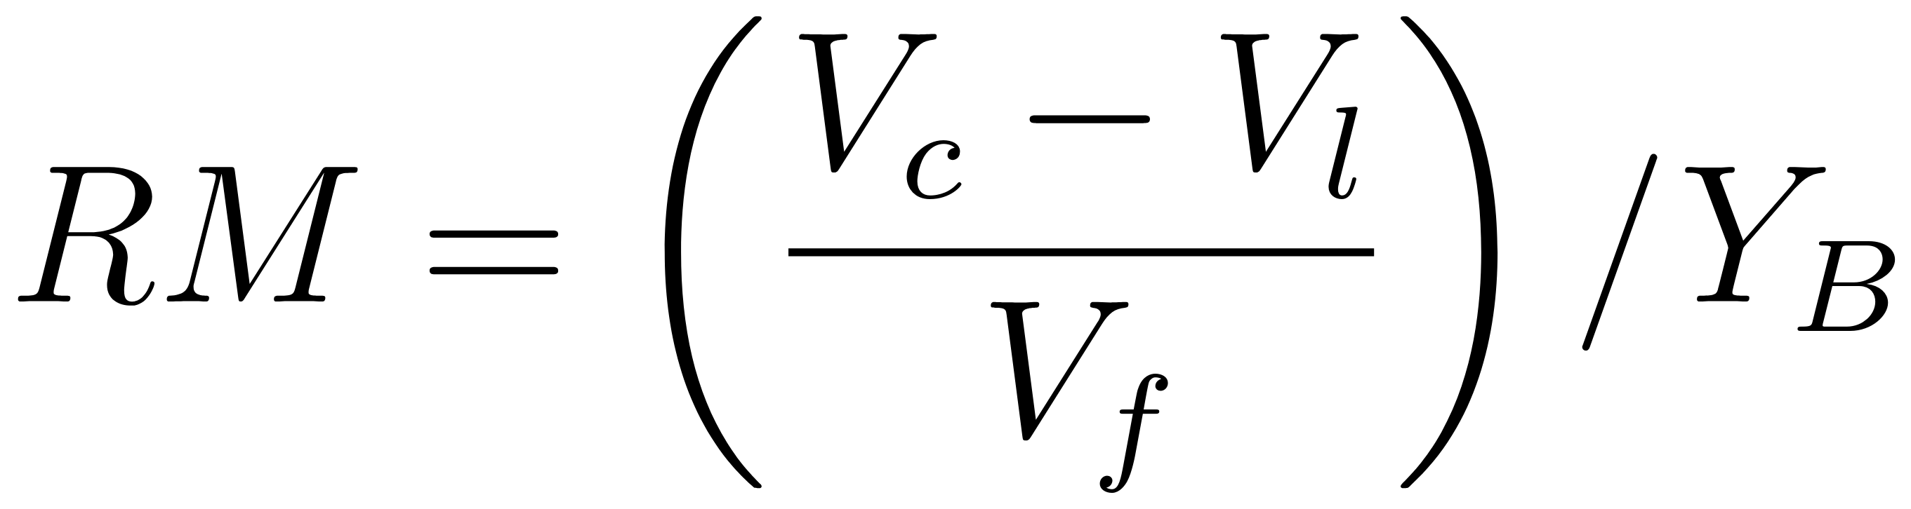
Results
Where RM is relative measure, Vc is current volume, Vl is pervious volume, and Vf is first measured volume. YB is years between measurements.

Slide 9
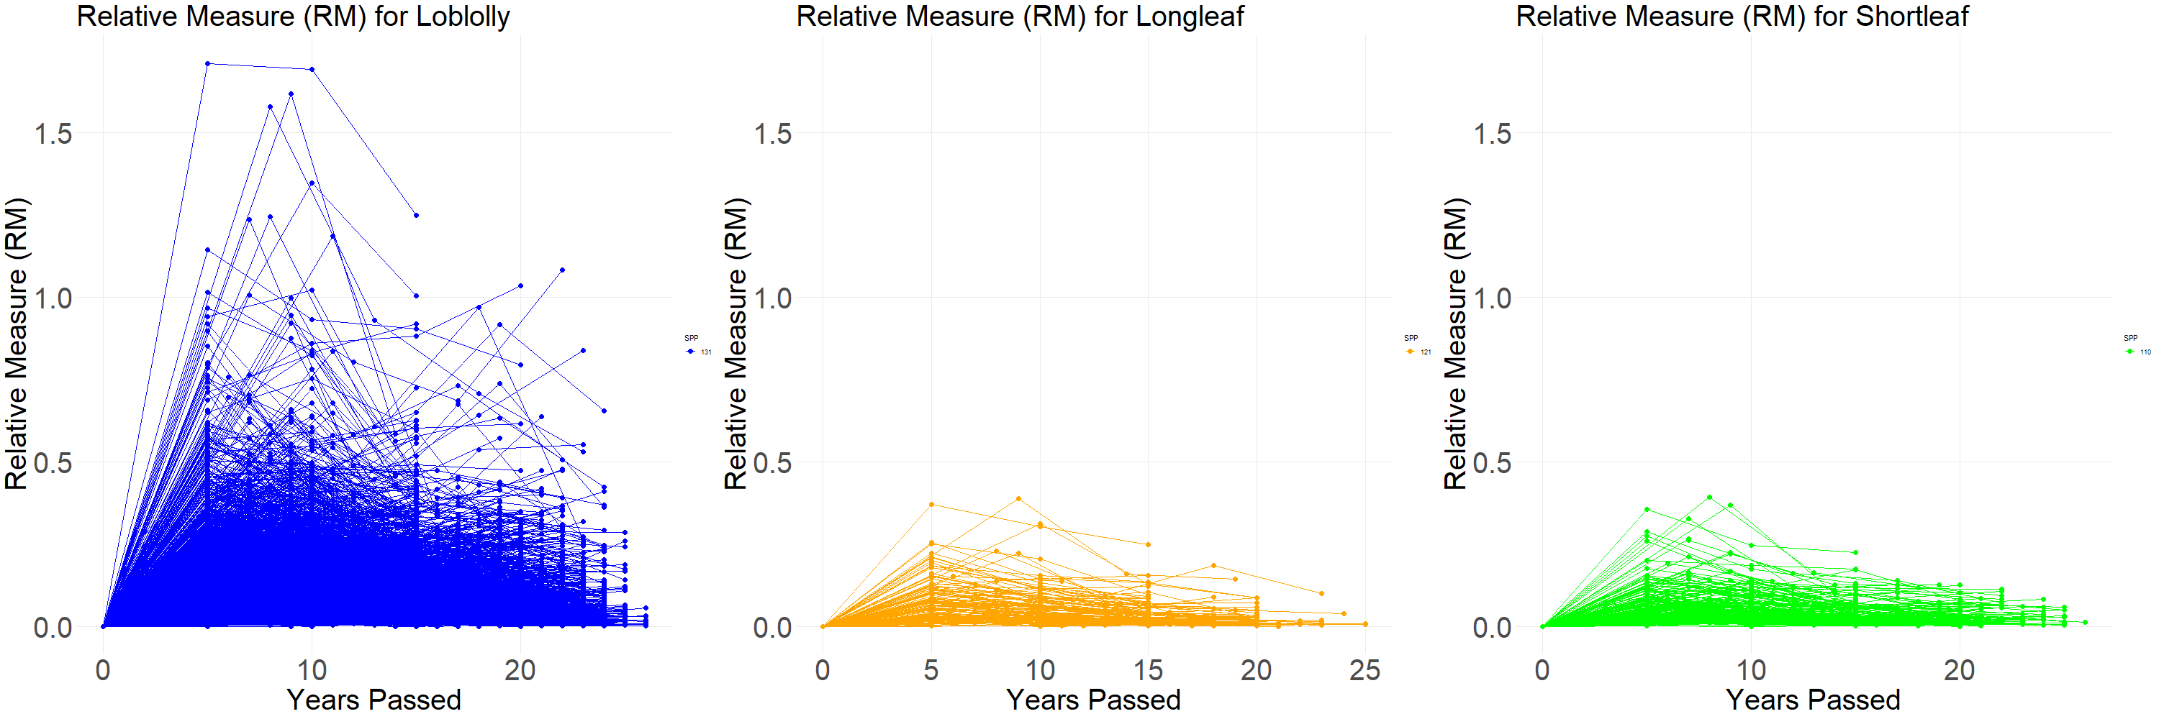
Results

Slide 10
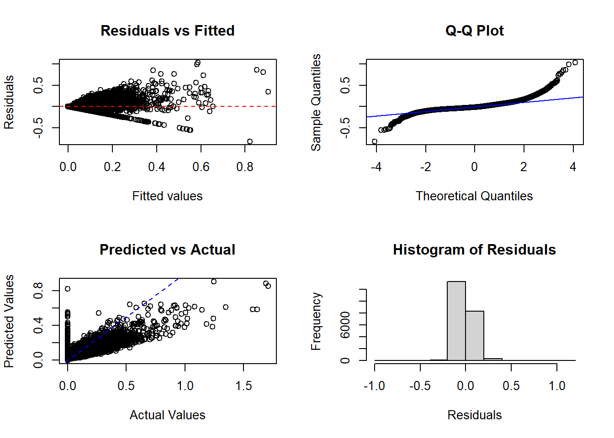
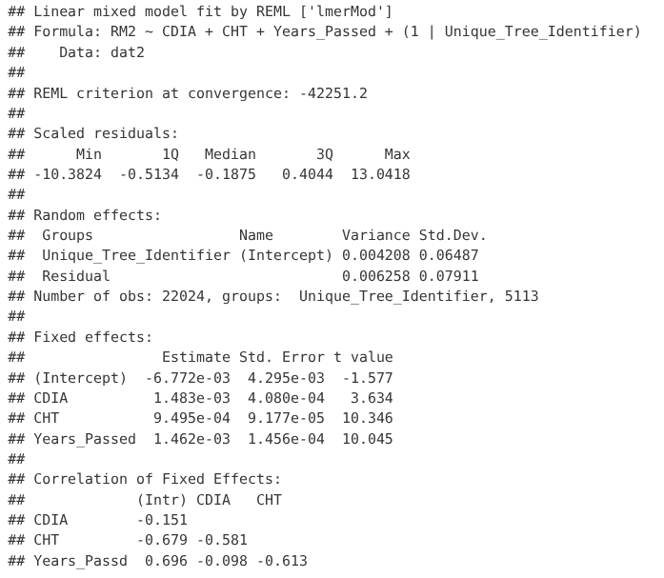
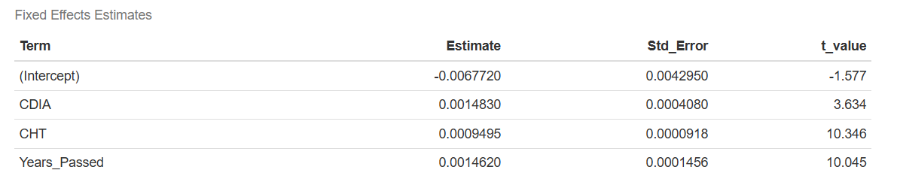
Results

Slide 11
Future Work
Non-linear regression.
Adjustments to RM Value.
Clustering Growth Curves.
Grouping site and regional parameters.
Apply and adjusting modeling framework to hardwoods species.
Considerations and Trail Markers.
Dr. Montes UGA lecture.
Ogana et al. (2025)

Slide 12


Acknowledgements
A special thank you to: Dr. Bullock and Kinane, Dr. Pete Bettinger, Dr. Ivan Raigosa-Garcia, and the PMRC for their help and guidance.
This project is funded by USDA Forest Service Grant Award No. 2018-68006-28095

